Slide 1
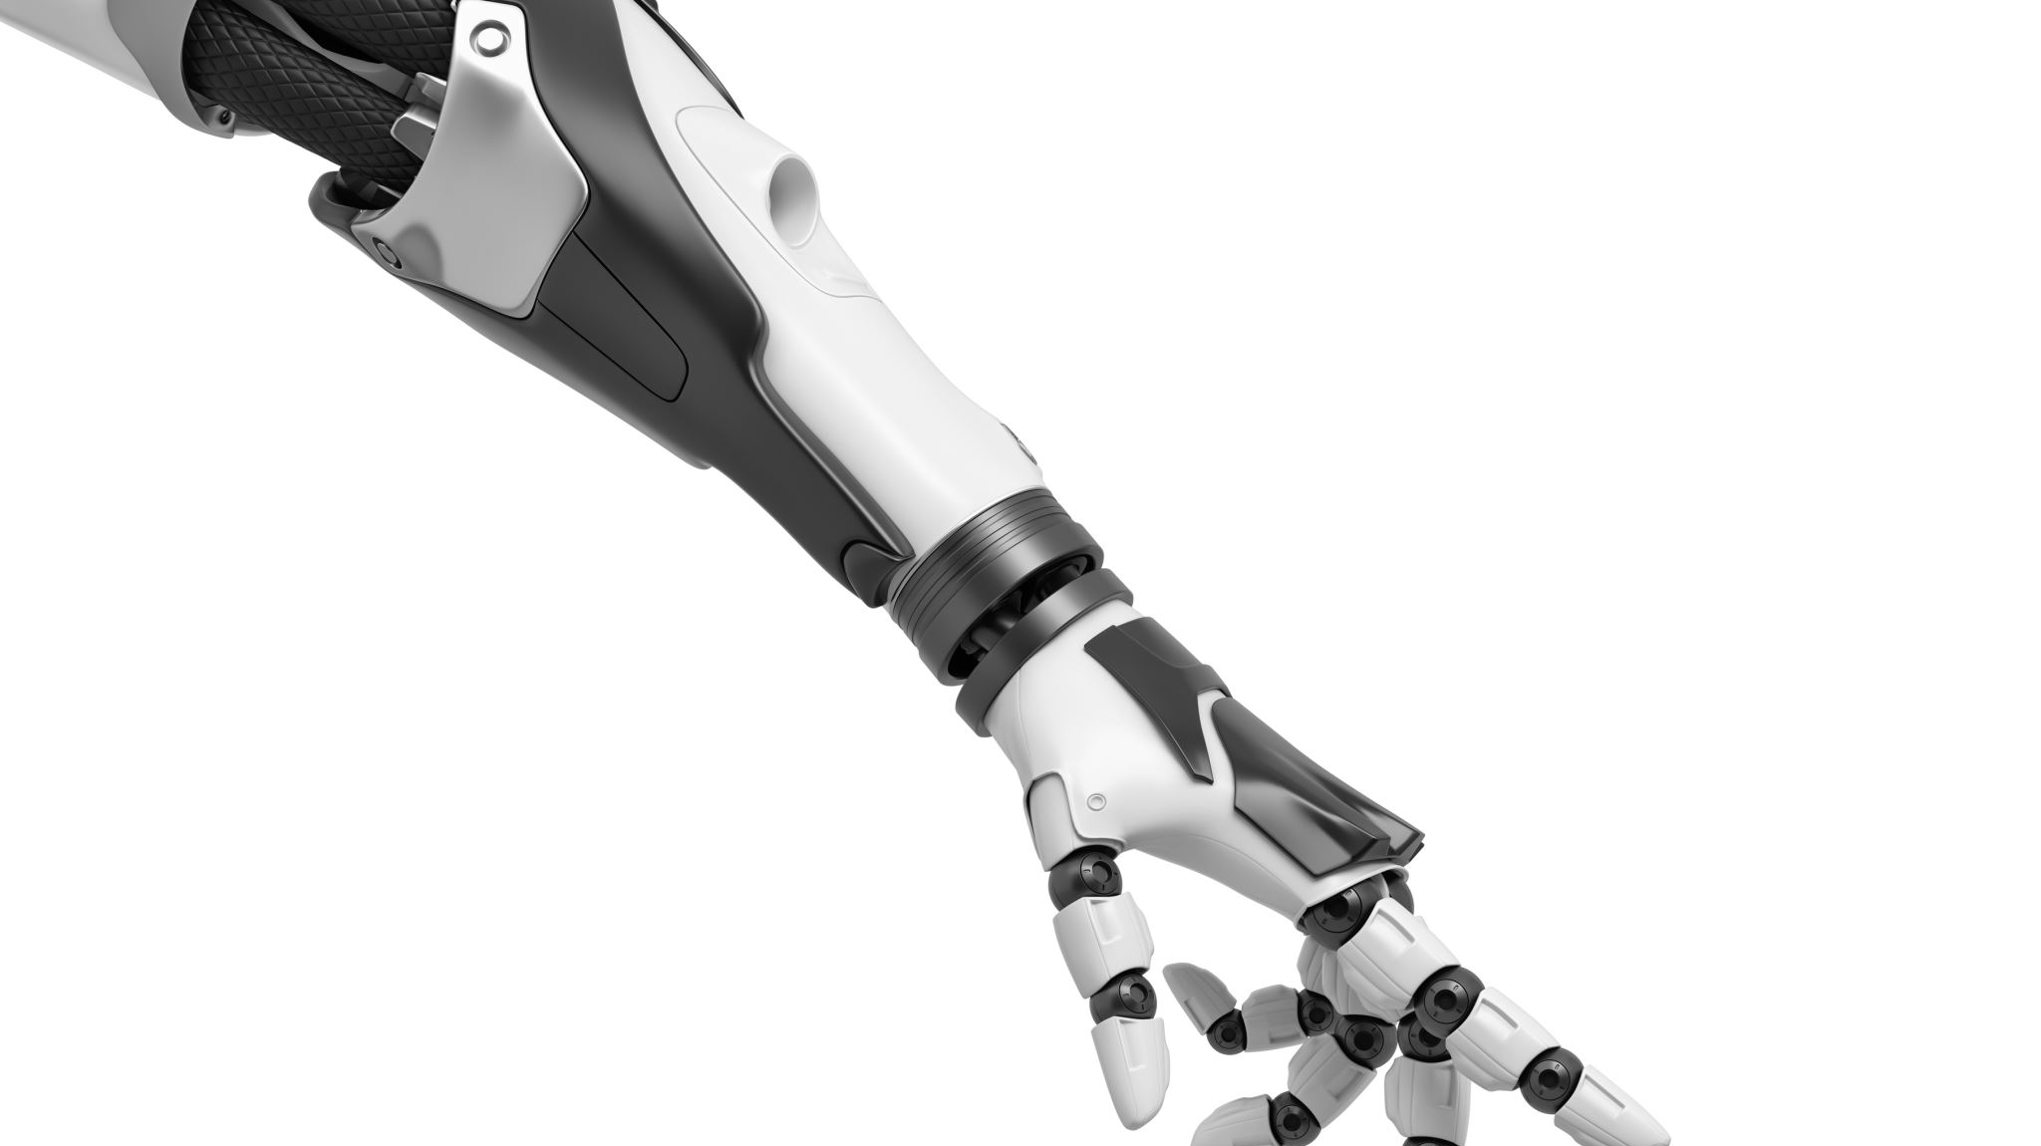
Virtual Reality Glove
By Mohamed Ouajdouni and Shivansh Shivansh

Slide 2

Agenda
Purpose
Scope
Hardware Design
Software Design
Challenges
Achievements
Result
Questions

Slide 3
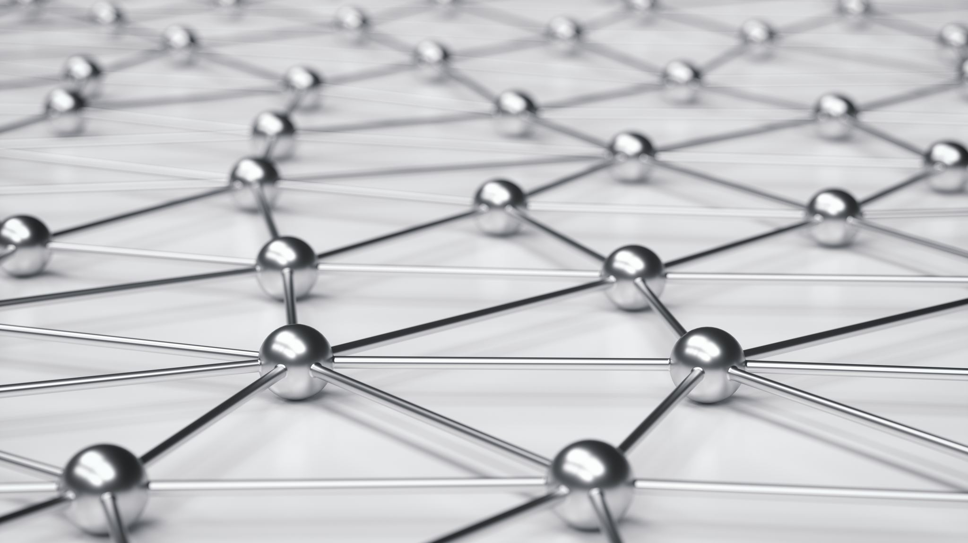
Purpose
Practice skills learned in CNT
Game development using Unity 3D
Real world example of technology

Slide 4
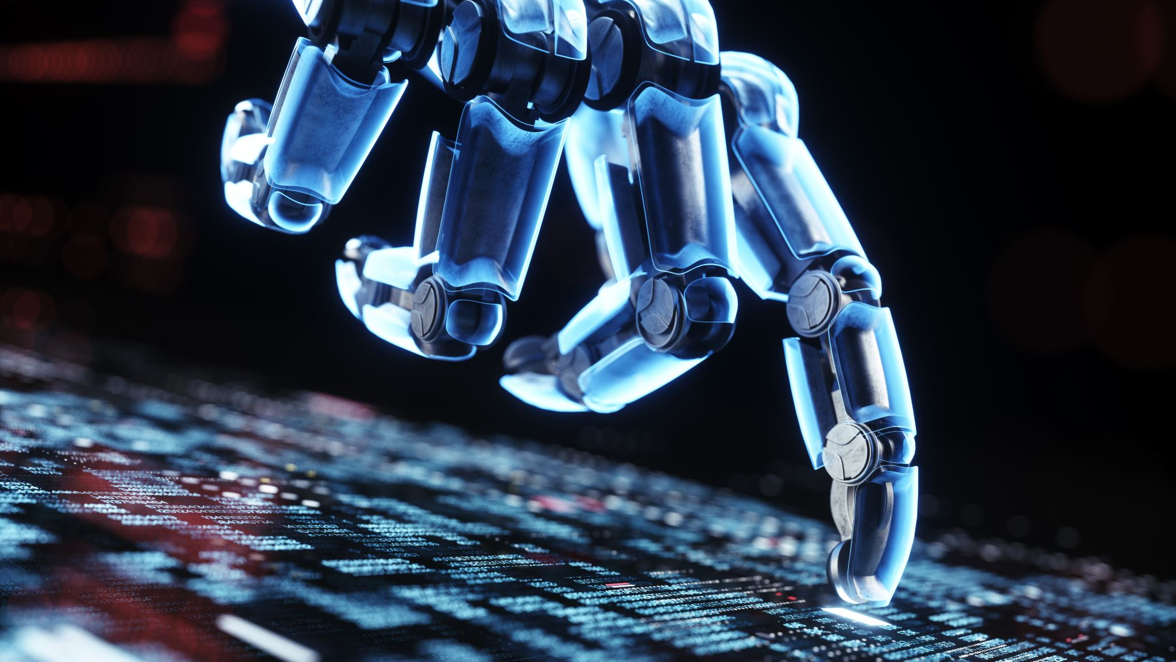
Scope
Build a VR glove with flex sensors and an orientation sensor
Convert flex sensor data to digital values to be used in Unity
Receive digital values through serial communication with Raspberry Pi
Assign and manipulate values to match virtual hand properties

Slide 5
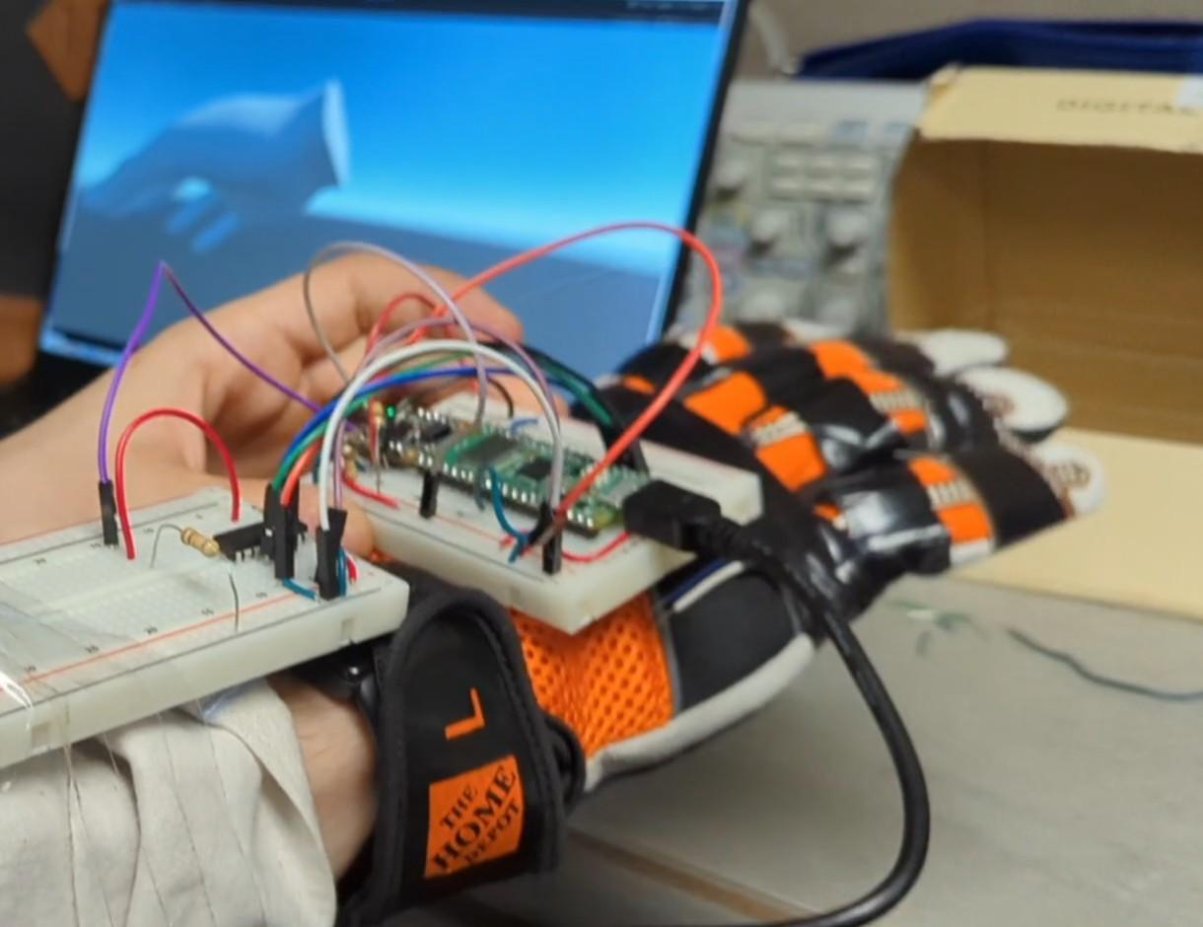
Hardware Design
A layered glove
Flex sensors
Raspberry pi pico microcontroller
MCP3008 ADC
BNO055 accelerometer/gyroscope sensor
Breadboard, jumper wires and resistors
Universal Serial Bus (USB)

Slide 6
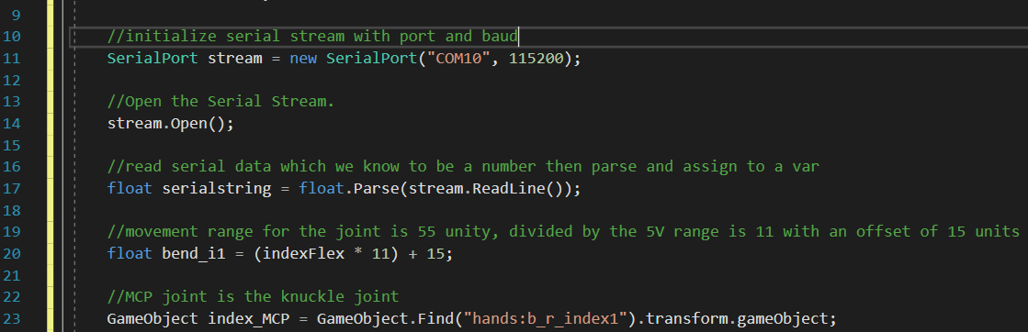
Software Design
Right Hand Model
Script in Unity 3D
Storing and parsing serial data
Manipulate numbers to match the model range
Assign to correct model object

Slide 7
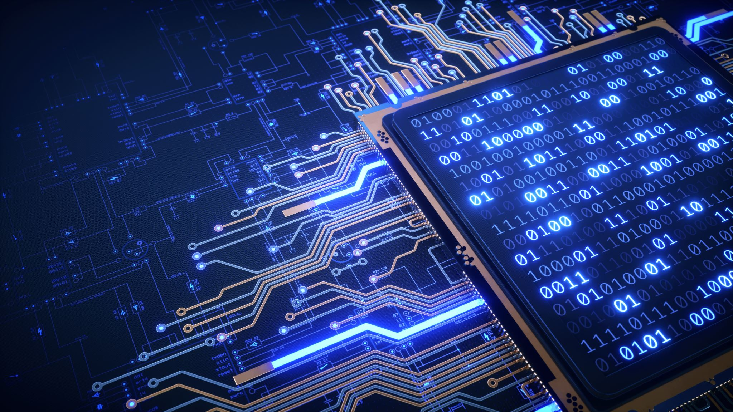
Challenges
Build our own flex sensors
ADC channels on Raspberry pi pico
Sending serial data through USB
Learning Unity 3D
Latency issues

Slide 8
Achievements
Curl the individual fingers
Accelerometer integrated with Unity
A virtually moving hand
Overcame latency with smoother experience

Slide 9
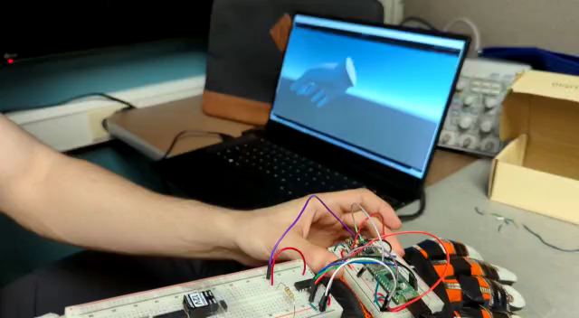
Result

Slide 10

Questions

